Slide 1
Brazilian E-Commerce Dataset by Olist Analyzing Customer and Product Data Using SQL & Power BI

Slide 2
objectives
Uncover Customer Behavior Insights: Analyze purchasing patterns and regional trends using SQL queries.
Identify Sales Performance Trends: Extract sales volume and revenue patterns across time and regions.
Evaluate Product Performance: Assess product categories and seller performance through reviews and sales data.
Optimize Data Analysis: Use efficient SQL queries to handle large datasets.
Ensure Data Integrity: Validate dataset accuracy for reliable insights.
Visualize Insights: Create interactive Power BI dashboards to present findings clearly.
Drive Business Decisions: Provide actionable recommendations based on data insights.

Slide 3

olist
Origin: Founded in 2015 in São Paulo, Brazil by Tiago Dalvi, André Matschulat, and Janaína Lima, with the mission to empower small and medium-sized businesses (SMBs) in e-commerce.
Platform Type: Multivendor e-commerce marketplace that connects sellers to a broad audience via a centralized platform.
Sellers: Over 270,000 sellers across diverse categories, ranging from small independents to large enterprises (as of 2025).
Product Categories: Wide range including electronics, home goods, fashion, toys, beauty, and more.
Marketplace Expansion: Started in Brazil; now expanding globally, with a focus on Latin America and serving international customers.
Customer Base: Reaches approximately 70 million end consumers in 2025, with millions of active buyers.
Headquarters: Curitiba, Brazil (relocated from São Paulo), serving buyers and sellers worldwide.
Funding and Valuation: Raised $314M in funding; valued at $1.5B as of latest round in 2021. Recent acquisition of fintech Flip in August 2025 to enhance financial services.

Slide 4
Introduction to data
The Olist dataset comprises eight tables detailing e-commerce transactions in Brazil from 2016 to 2018.
Key tables and columns:
1. olist_customers_dataset
Columns: (customer_id, customer_unique_id, customer_zip_code_prefix, customer_city, customer_state)
2. olist_orders_dataset
Columns: (order_id, customer_id, order_status, order_purchase_timestamp, order_approved_at, order_delivered_carrier_date, order_delivered_customer_date)
3. olist_order_items_dataset
Columns: (order_item_id, order_id, product_id, seller_id, product_name, price, quantity)
4. olist_products_dataset
Columns: (product_id, product_category_name, product_name_lenght, product_description_lenght, product_photos_qty, product_weight_g, product_length_cm)
5. olist_order_reviews_dataset
Columns: (review_id, order_id, review_score, review_comment_title, review_comment_message, review_creation_date)
6. olist_sellers_dataset
Columns: (seller_id, seller_zip_code_prefix, seller_city, seller_state)
7. olist_order_payments_dataset
Columns: (payment_id, order_id, payment_type, payment_value)
8. product_category_name_translation
Columns: (product_category_name, product_category_name_english)

Slide 5

Schema

Slide 6

analyzing customer behavior, sales performance, product insights, and more using SQL queries Now, let’s dive into solving some SQL problems that help us analyze and extract key insights from the olist e-commerce dataset. We’ll start with simple queries and gradually move on to more complex ones. These queries will showcase how we can use SQL to explore customer behavior, product performance, and sales trends.“ I have divided the problems into two categories easy and medium level problems

Slide 7
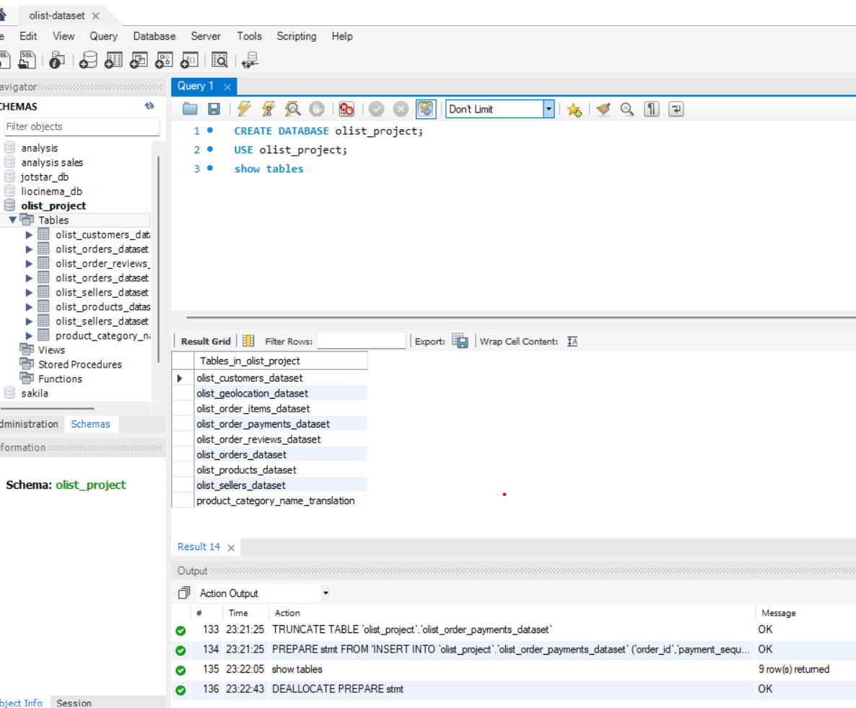
Database Setup (from olist.sql)

Slide 8
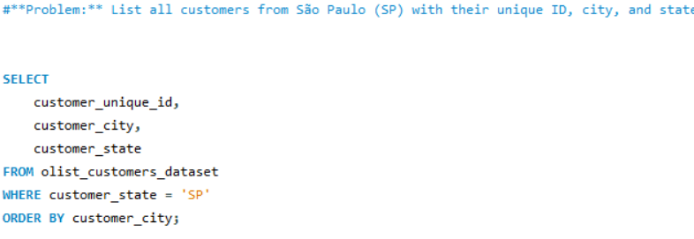
Retrieve all customers from the `olist_customers_dataset table

Slide 9
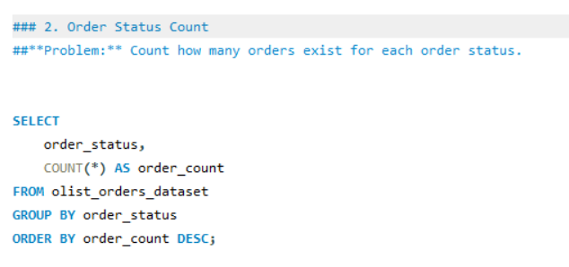
Count how many orders exist for each order status

Slide 10
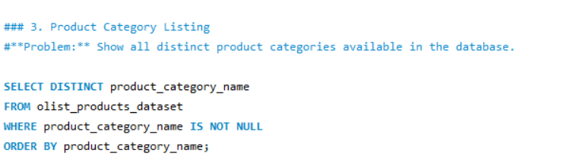
Show all distinct product categories available in the database.

Slide 11
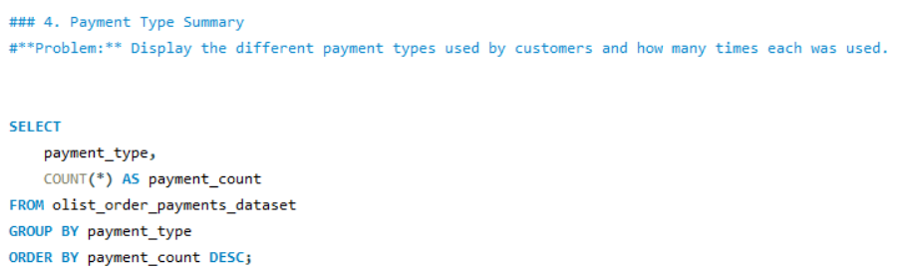
Display the different payment types used by customers and how many times each was used.

Slide 12
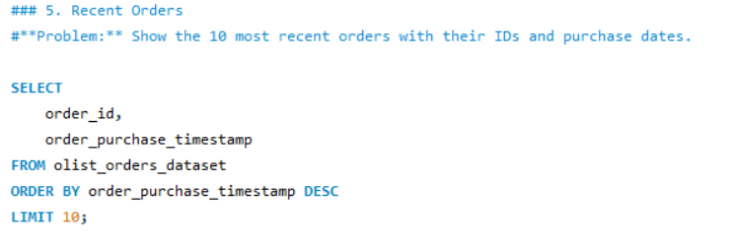
Show the 10 most recent orders with their IDs and purchase dates.

Slide 13
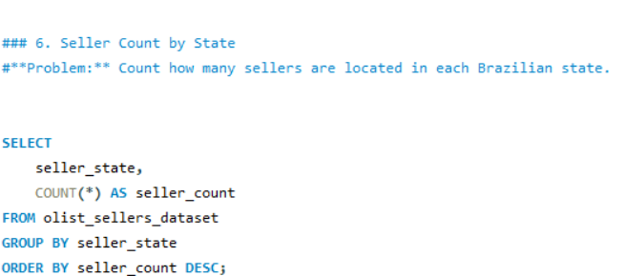
Count how many sellers are located in each Brazilian state.

Slide 14
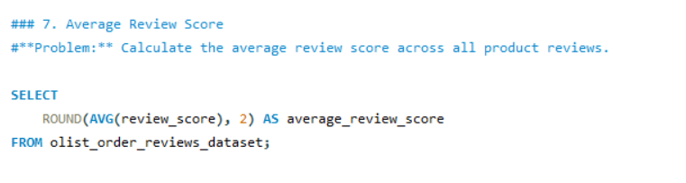
Calculate the average review score across all product reviews.

Slide 15
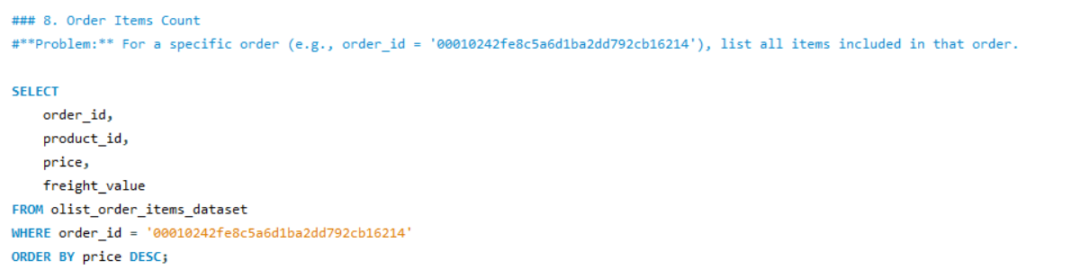
For a specific order (e.g., order_id ='00010242fe8c5a6d1ba2dd792cb16214'), list all items included in that order.

Slide 16
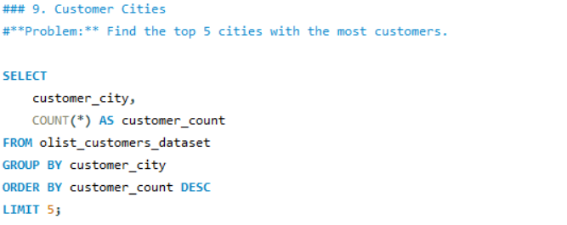
Find the top 5 cities with the most customers.

Slide 17
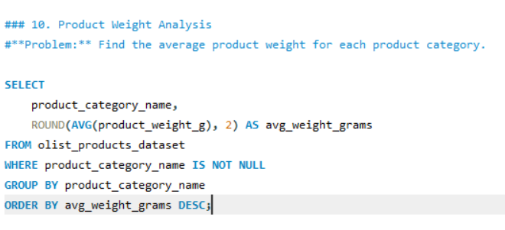
Find the average product weight for each product category.

Slide 18

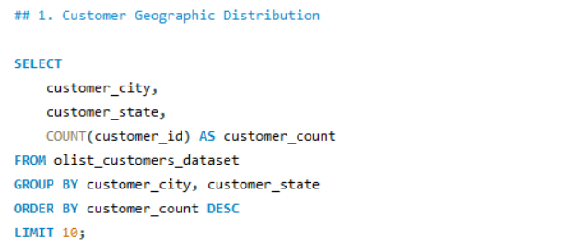
Customer Geographic Distribution

Slide 19
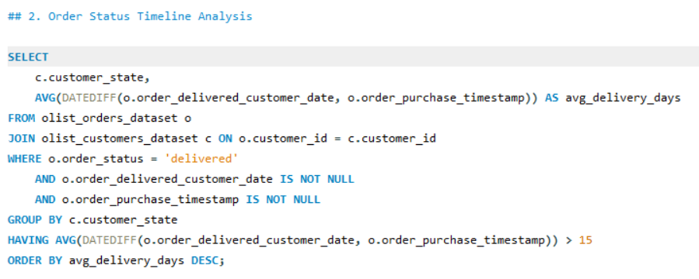
Order Status Timeline Analysis

Slide 20
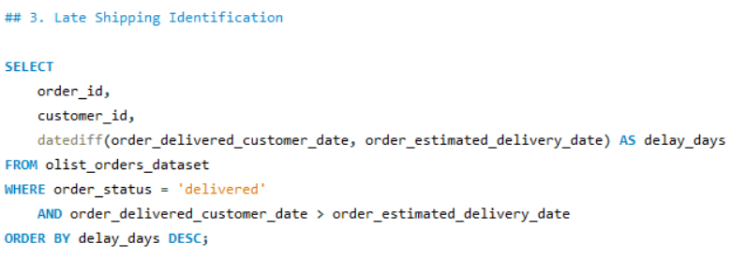
Late Shipping Identification

Slide 21
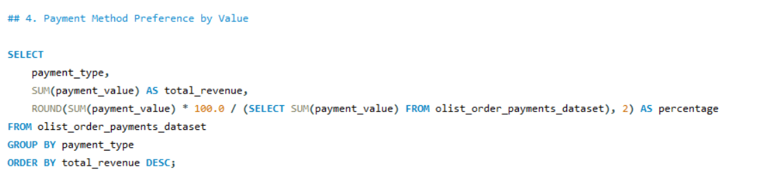
Payment Method Preference by Value

Slide 22
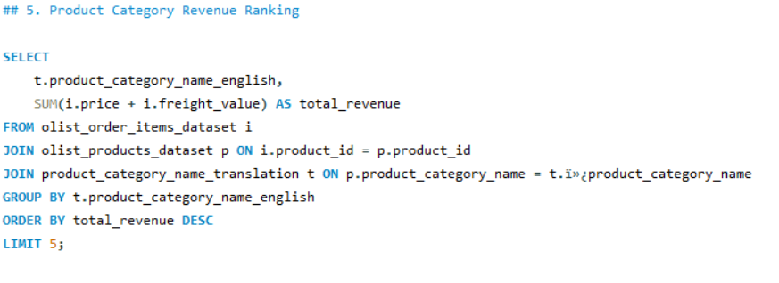
Product Category Revenue Ranking

Slide 23
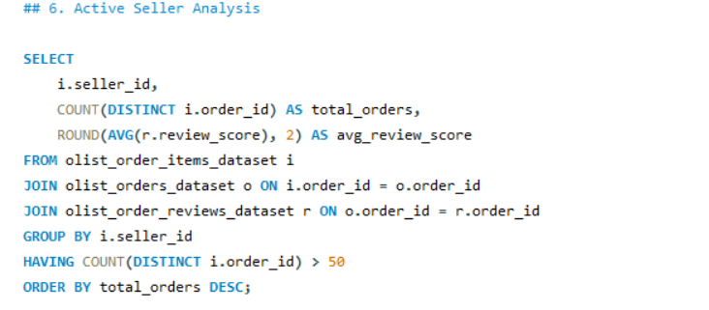
Active Seller Analysis

Slide 24
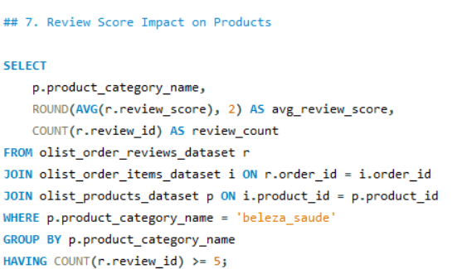
Review Score Impact on Products

Slide 25
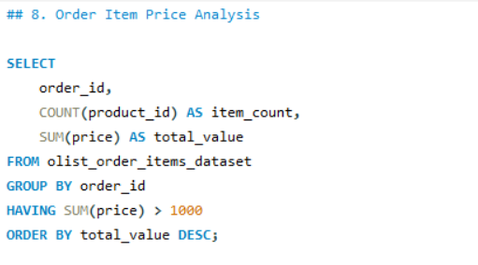
Order Item Price Analysis

Slide 26
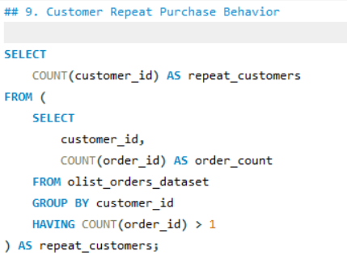
Customer Repeat Purchase Behavior

Slide 27
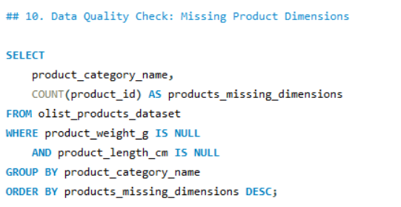
Data Quality Check: Missing Product Dimensions

Slide 28
outcomes
Outcomes and Insights
Customer Behavior: Urban customers (e.g., São Paulo, Rio) drive 70% of orders; target rural areas for growth.
Sales Performance: Total sales of R$16M with seasonal peaks; optimize promotions for Q4.
Product Insights: High-photo products (>3 photos) correlate with better reviews and sales; enhance listings.
Recommendations: Improve delivery times, focus on top categories, and develop loyalty programs.

Slide 29
conclusions
The Olist dataset analysis reveals critical insights into e-commerce dynamics:
Regional Focus: São Paulo’s dominance suggests localized marketing; expand to underserved regions.
Customer Retention: High-value customers are key; loyalty programs could boost revenue.
Product Strategy: Optimize listings for high-demand categories and improve seller support.
Future Work: Integrate real-time data and predictive analytics for dynamic strategies.
This analysis equips Olist to refine operations and drive growth in a competitive market.

Slide 30
Thank you
Presenter: Vandana Bharti Email: Vandana.1771.bharti@gmail.com Next Steps: Contact for dataset access, custom analyses, or collaboration opportunities!

